Slide 1
WELCOME
Class: B.Com – Part-1
Subject: Financial Accounting
TOPIC: Branch Accounts – Part - 3
Prepared By
Dr. SHAHID IQBAL
Guest Faculty
Marwari College, Darbhanga,
Mobile No. and Whatsup No. : 7004160257
Email ID: shahidlnmu@gmail.com

Slide 2
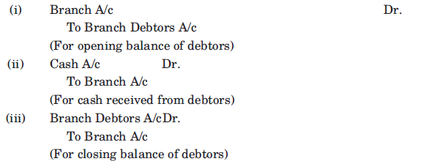
(B) Branch receiving goods from head office at cost price and making both cash and credits sales :
If branch is authorised to sale goods cash as well as credit, the following entries are also included in respect of credit sales in addition to the above entries discussed earlier :
  (i) Opening balance of debtors
  (ii) Cash received from debtors
  (iii) Closing balance of debtors
For the above items, the following journal entries are made by the H.O.:

Slide 3

Posting in Branch Account :
The posting of above entries in branch account to be included is as following:
The effect of posting of three items in branch account is that net sale are automatically credited. In other words, sales returns, discount and allowances allowed, bad debts have already been deducted from sales. Hence no entry is required to be passed by the head office in branch account in respect of the following :
  (i) Goods sold on credit
  (ii) Goods returned by debtors
  (iii) Discount allowed to debtors
  (iv) Bad debts written off
  (v) Allowance allowed to debtors

Slide 4
(C) When goods are supplied to branch by head office at invoice or selling price :
Sometimes goods are sent to branch by the head office at a price higher than cost price. For example, if cost of goods is ` 8,000 and goods are invoiced at a profit of 20% on cost, the perform invoice will show the value of goods at ` 9,600. The following are the advantages of invoicing goods at invoice price :
(i) It is possible to maintain secrecy about the actual cost and profits, from branches personnel.
(ii) The branch can be directed to sell the goods at the invoice price only or more.
(iii) control over stock with the branch becomes slightly easier.
When goods are invoiced at invoice price, question will be attempted in the same manner as discussed under cost price method but opening stock, goods supplied to branch, goods
returned by branch and closing stock are to be shown at invoice price and not at cost price.

Slide 5
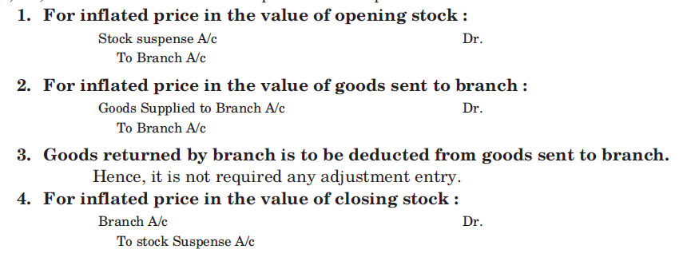
When goods are invoiced at invoice price, question will be attempted in the same manner as discussed under cost price method but opening stock, goods supplied to branch, goods returned by branch and closing stock are to be shown at invoice price and not at cost price.
While calculating the branch profit or loss, adjustment entries are required to be made in the branch Account for profit included in the above mentioned items so the branch account shows true profit or loss. Hence, the following adjustment entries are to be passed for inflated price, i.e., difference between invoice price and cost price :

Slide 6
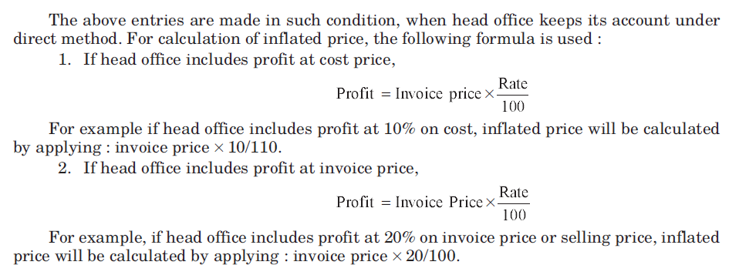

Slide 7
Thank You

